Slide 1

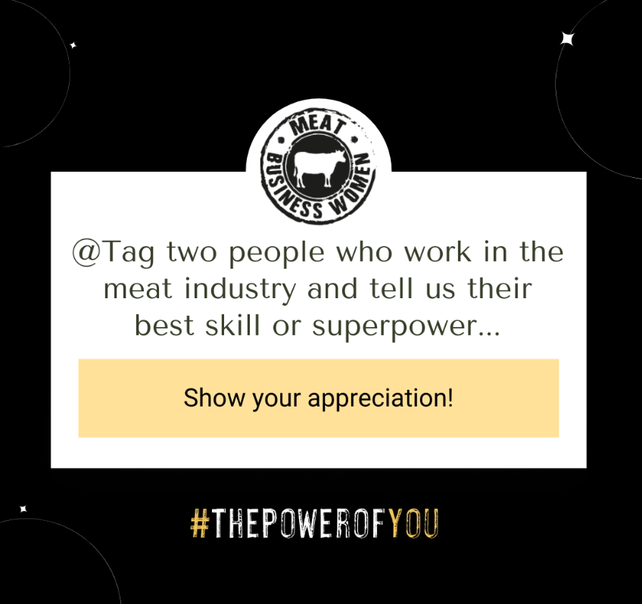

International Women’s Day 2024
8 March 2024
SOCIAL
TOOLKIT

Slide 2




IN THIS TOOLKIT YOU’LL FIND:
social campaign overview
how can you use this content?
CAMPAIGN CONTENT

Slide 3
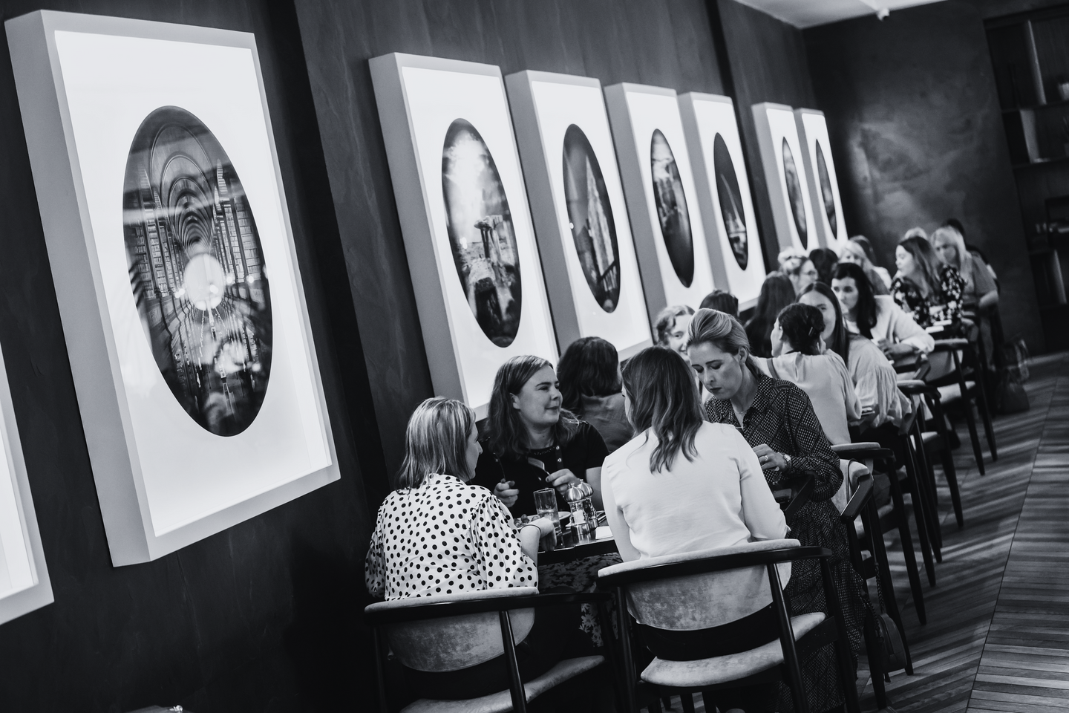

the campaign
campaign FOCUS
The campaign idea revolves around leveraging International Women’s Day (IWD) as a pivotal moment to highlight and celebrate the achievements, leadership and contributions of women in the meat industry.
Meat Business Women is the leading network for professional women in the global meat industry, recognises the importance of this day to amplify our mission - to ensure the meat industry is an attractive sector for women to work in, and to support the professional development of women within the industry.
By engaging with IWD, Meat Business Women aims to further champion the role of women in the meat sector.
why get involved
To increase engagement around women in the meat industry
To amplify the achievements of women across our industry
To educate your personal followers or business page’s audience on International Women’s Day and the Meat Business Women community

Slide 4



the campaign
Content use
linkedin
twitter
instagram
Graphics to be used on LinkedIn:
Graphics to be used on Twitter:
Graphics to be used on Instagram:
SQUARE GRAPHICS (Examples below)
RECTANGLE GRAPHICS (Examples below)
SQUARE GRAPHICS and PORTRAIT graphics for stories (Examples below)
1200 x 1200
1600 x 900
1200 x 1200
1080 x 1920

Slide 5

OPENING GRAPHIC
Friday 8 March 2024
Suggested accompanying post copy:
Today, we stand together to celebrate the incredible women of the meat industry. From the farm to the boardroom and everything in between, women are driving innovation, championing sustainability, and leading with courage and compassion.
This International Women's Day, with this year’s theme of #InspireInclusion, let's recognise the diverse roles women play in our industry and the unique perspectives they bring. Our @MeatBusinessWomen community represents the unity, diversity, and empowerment of women in the meat business, embodying our commitment to growth, sustainability, and innovation.
Join us in championing the achievements and contributions of women across the meat sector and let's pledge to support and uplift each other, today and every day.
#InternationalWomensDay #MeatBusinessWomen #CelebrateWomen
Download the assets here.

Slide 6


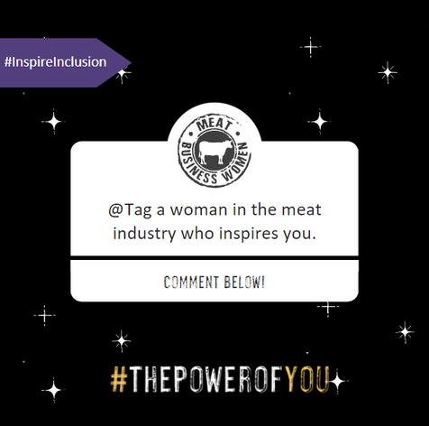
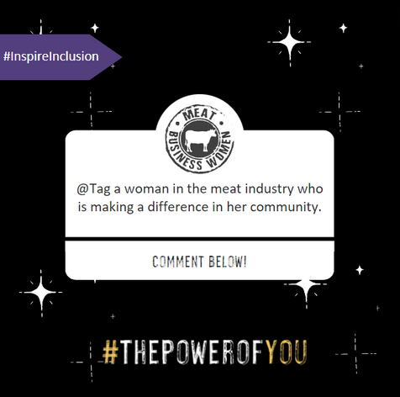
GENERAL social media POSTS
To use during Friday 8 March and post IWD
Suggested accompanying post copy:
*If posting after IWD please remove reference at beginning of copy
Post 1: This #InternationalWomensDay, let’s spotlight the women who inspire and innovate in the meat industry.
🌟Tag woman who inspire you in your career
Join us in honouring the power and progress of women in the meat industry.
#InspireInclusion #ThePowerOfYou #IWD
Post 2: On #InternationalWomensDay, let’s recognise the women making a meaningful impact in their communities through their work in the meat industry.
🌍Tag a woman whose community-driven efforts inspire you.
#InspireInclusion #ThePowerOfYou #IWD
Download the assets here.

Slide 7
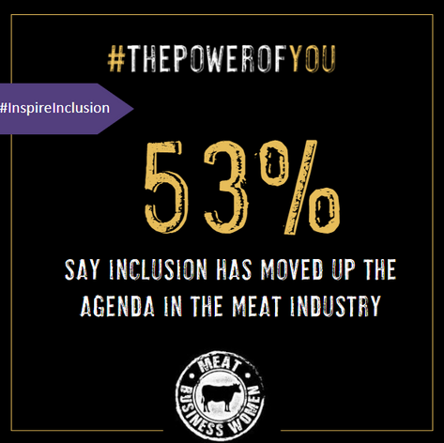
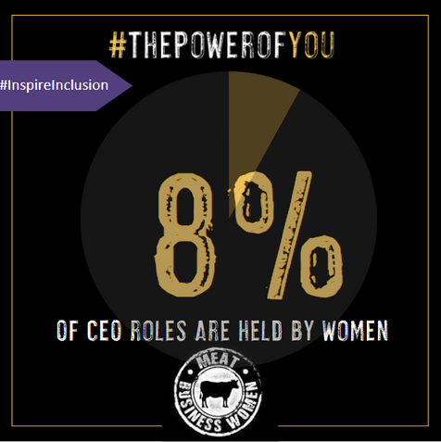
STAT social POSTS
To use during Friday 8 March and post IWD
Choose a stat that speaks from your business or from you personally.
Suggested copy:
The meat industry is evolving, becoming more gender-inclusive every day. But our journey isn’t over.
..then support your copy with:
Post 1: Did you know that 53% of females say inclusion has moved up the agenda in the meat industry?
@Meat Business Women has shown that the meat industry has made progress in shifting the dial of women’s representation, but there’s still more to be done.
Read more about the findings from the report here: https://www.meatbusinesswomen.org/resource/gender-representation-report-2023.html
#PowerOfYou #InspireInclusion #IWD
Post 2: Did you know only 8% of CEO roles are held by women? It’s a reminder that we’ve come far, yet there's more to do.
@Meat Business Women has shown that the meat industry has made progress in shifting the dial of women’s representation, but there’s still more to be done.
Read more about the findings from the report here: https://www.meatbusinesswomen.org/resource/gender-representation-report-2023.html
#PowerOfYou #InspireInclusion #IWD
Download the assets here.

Slide 8
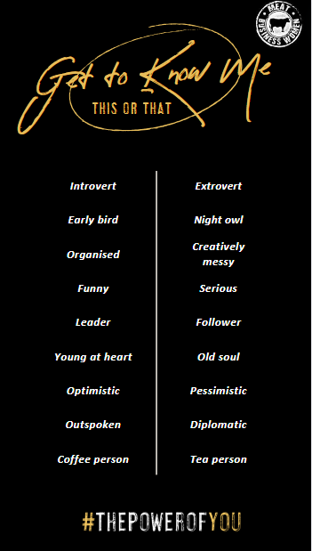
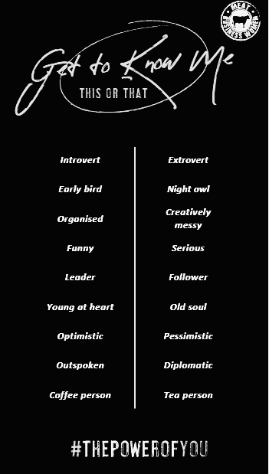
INSTAGRAM STORY POSTS
To use during Friday 8 March
Download the assets here.
Choose a story graphic that you feel appropriate to share:
Story: A personal story for members to share either via Instagram or within MBW group throughout the day.
More for personal use but could be used on organisation channel, with highlighting the employee who has answered the questions.

